Slide 1


S/MIME
Dr.Nadine
By: Hasan Akil

Slide 2



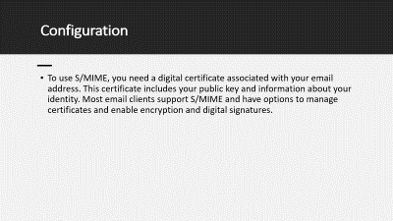
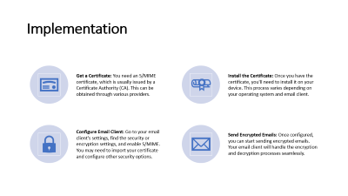
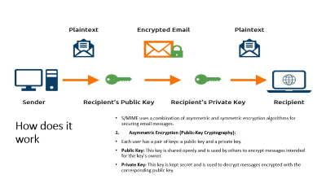
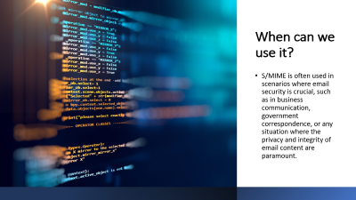
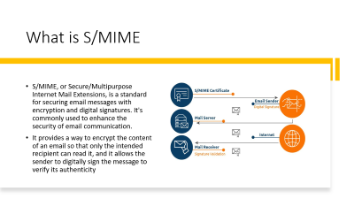
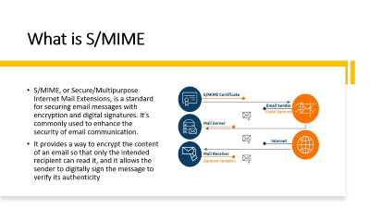
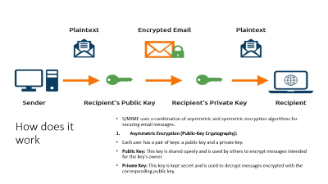
EXIT
What is S/MIME

Slide 3


EXIT
How S/Mime Works

Slide 4
EXIT
Usage

Slide 5
EXIT
Configuration

Slide 6
EXIT
Implemenation

Slide 7

Summary
What is S/MIME
How it works
S/MIME Algorithms
Usage
Configuration
Implementation

Slide 8

Thanx for watching
Return

Slide 9

Done BY : Hasan Akil

Slide 10
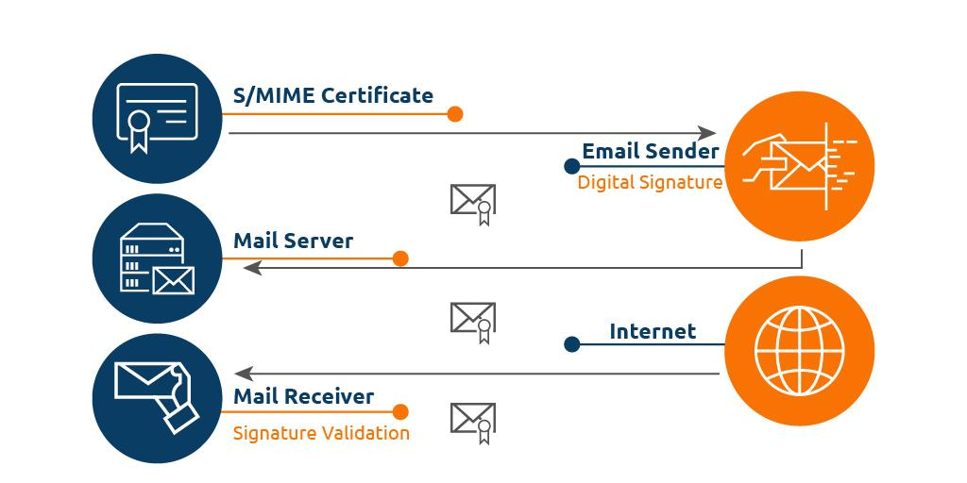
What is S/MIME
S/MIME, or Secure/Multipurpose Internet Mail Extensions, is a standard for securing email messages with encryption and digital signatures. It's commonly used to enhance the security of email communication.
It provides a way to encrypt the content of an email so that only the intended recipient can read it, and it allows the sender to digitally sign the message to verify its authenticity

Slide 11
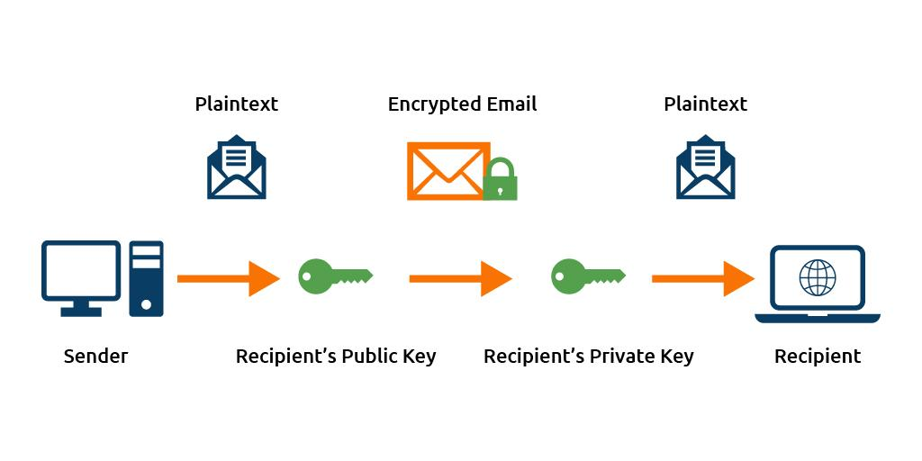
How does it work
S/MIME uses a combination of asymmetric and symmetric encryption algorithms for securing email messages.
Asymmetric Encryption (Public-Key Cryptography):
Each user has a pair of keys: a public key and a private key.
Public Key: This key is shared openly and is used by others to encrypt messages intended for the key's owner.
Private Key: This key is kept secret and is used to decrypt messages encrypted with the corresponding public key.

Slide 12
2. Digital Enveloping (Symmetric Encryption):
To encrypt the actual content of the email, a symmetric encryption algorithm is used.
A random symmetric key is generated specifically for that email (session key).
The content of the email is encrypted with the symmetric key (data encryption).
3. Combining Asymmetric and Symmetric Encryption:
The symmetric key (session key) used for encrypting the content is then encrypted with the recipient's public key.
This encrypted symmetric key is sent along with the encrypted content.
4. Recipient Decryption:
The recipient uses their private key to decrypt the symmetric key from the received message.
With the symmetric key now available, they can decrypt the actual content of the email.

Slide 13

S/MIME supports multiple algorithms, and the choice can depend on factors like security requirements, key length, and compatibility with different systems.
Asymmetric Encryption (Public-Key):
RSA (Rivest-Shamir-Adleman)
DSA (Digital Signature Algorithm)
ECC (Elliptic Curve Cryptography)
Symmetric Encryption:
AES (Advanced Encryption Standard)
3DES (Triple Data Encryption Standard)
CAST5 (CAST-128)

Slide 14






Slide 15
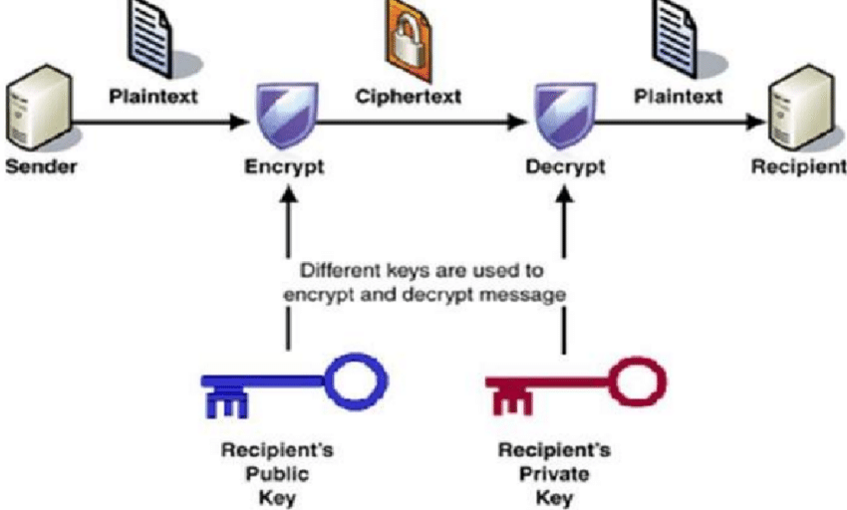
RSA

Slide 16
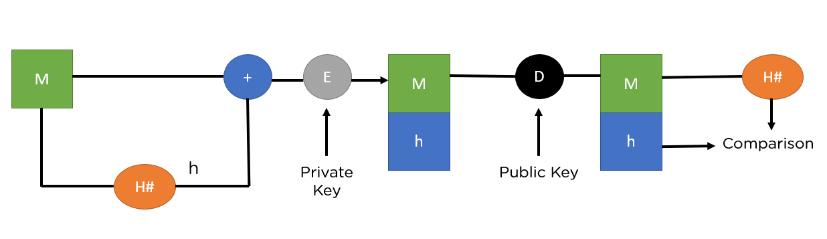
DSA

Slide 17
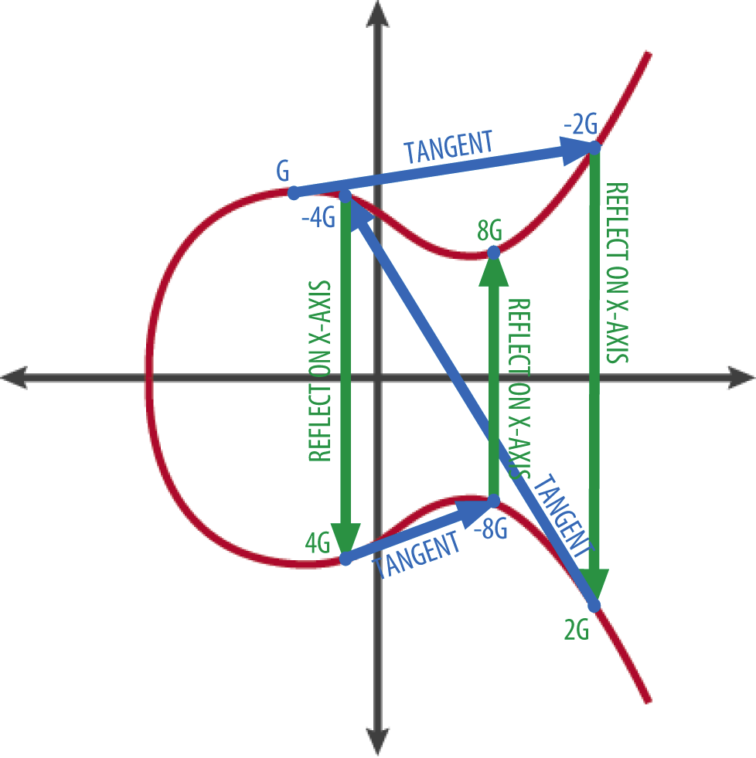
ECC
ECC
Elliptic Curve Cryptography (ECC) is a type of public-key cryptography that relies on the mathematics of elliptic curves for securing communication. ECC is particularly known for providing strong security with shorter key lengths compared to traditional public-key algorithms like RSA.
ECC's strength lies in the difficulty of the Elliptic Curve Discrete Logarithm Problem, which makes it computationally infeasible for an attacker to reverse the process and derive the private key from the public key.

Slide 18
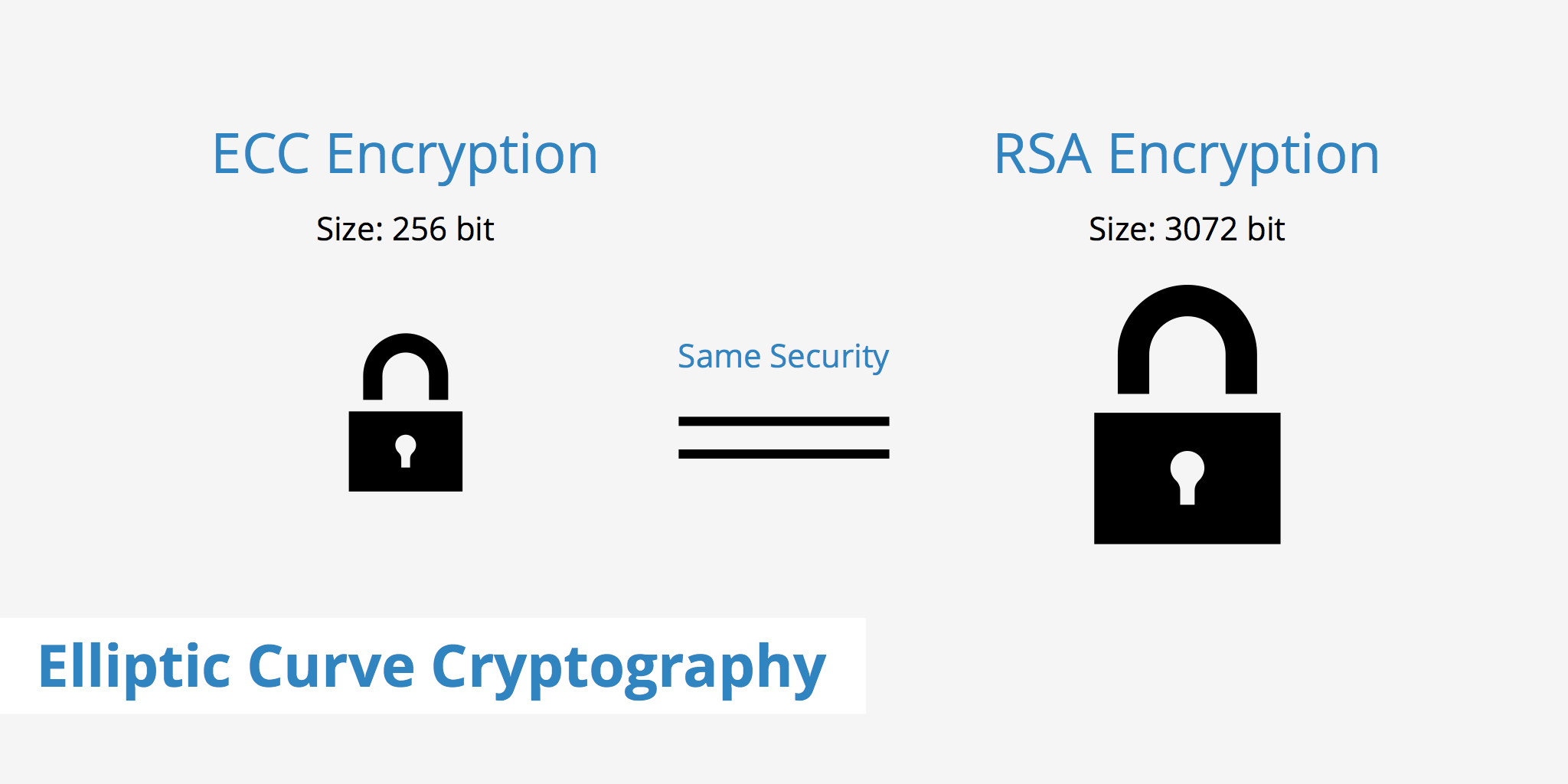

Slide 19
Key Generation:
Each user involved in the communication generates a pair of keys: a public key and a private key.
The public key is derived from a point on an elliptic curve, and the private key is a random number.
Elliptic Curve Equation:
ECC is based on the mathematical properties of elliptic curves, which are defined by an equation of the form: y2=x3+ax+b.
The elliptic curve is defined over a finite field, meaning all the arithmetic operations are performed modulo a prime number.
Point Addition on the Curve:
The elliptic curve has a geometric interpretation, where points on the curve can be added together.
Point addition is defined in a way that if you have two points A and B, you can compute a third point C = A + B.
Scalar Multiplication:
Scalar multiplication involves repeatedly adding a point to itself a certain number of times.
If k is a scalar (the private key), then kP involves adding the point P to itself k times.
Public Key Derivation:
The public key is derived by performing scalar multiplication on a base point (a well-defined point on the curve) with the private key.
Encryption Process:
When Alice wants to send a confidential message to Bob, she obtains Bob's public key (a point on the elliptic curve derived from his private key).
Alice generates a random symmetric key (for example, for AES encryption) for the actual data encryption.
She then performs ECC operations to derive a shared secret by multiplying Bob's public key with her private key.
This shared secret is then used to derive encryption keys for symmetric encryption.
The symmetric key is used to encrypt the actual message using a symmetric encryption algorithm.
Decryption Process:
Bob, the recipient, uses his private key to derive the same shared secret by multiplying it with Alice's public key.
With the shared secret, he can derive the same symmetric key that Alice used for encryption.
Bob uses the symmetric key to decrypt the received message and recover the original content.

Slide 20
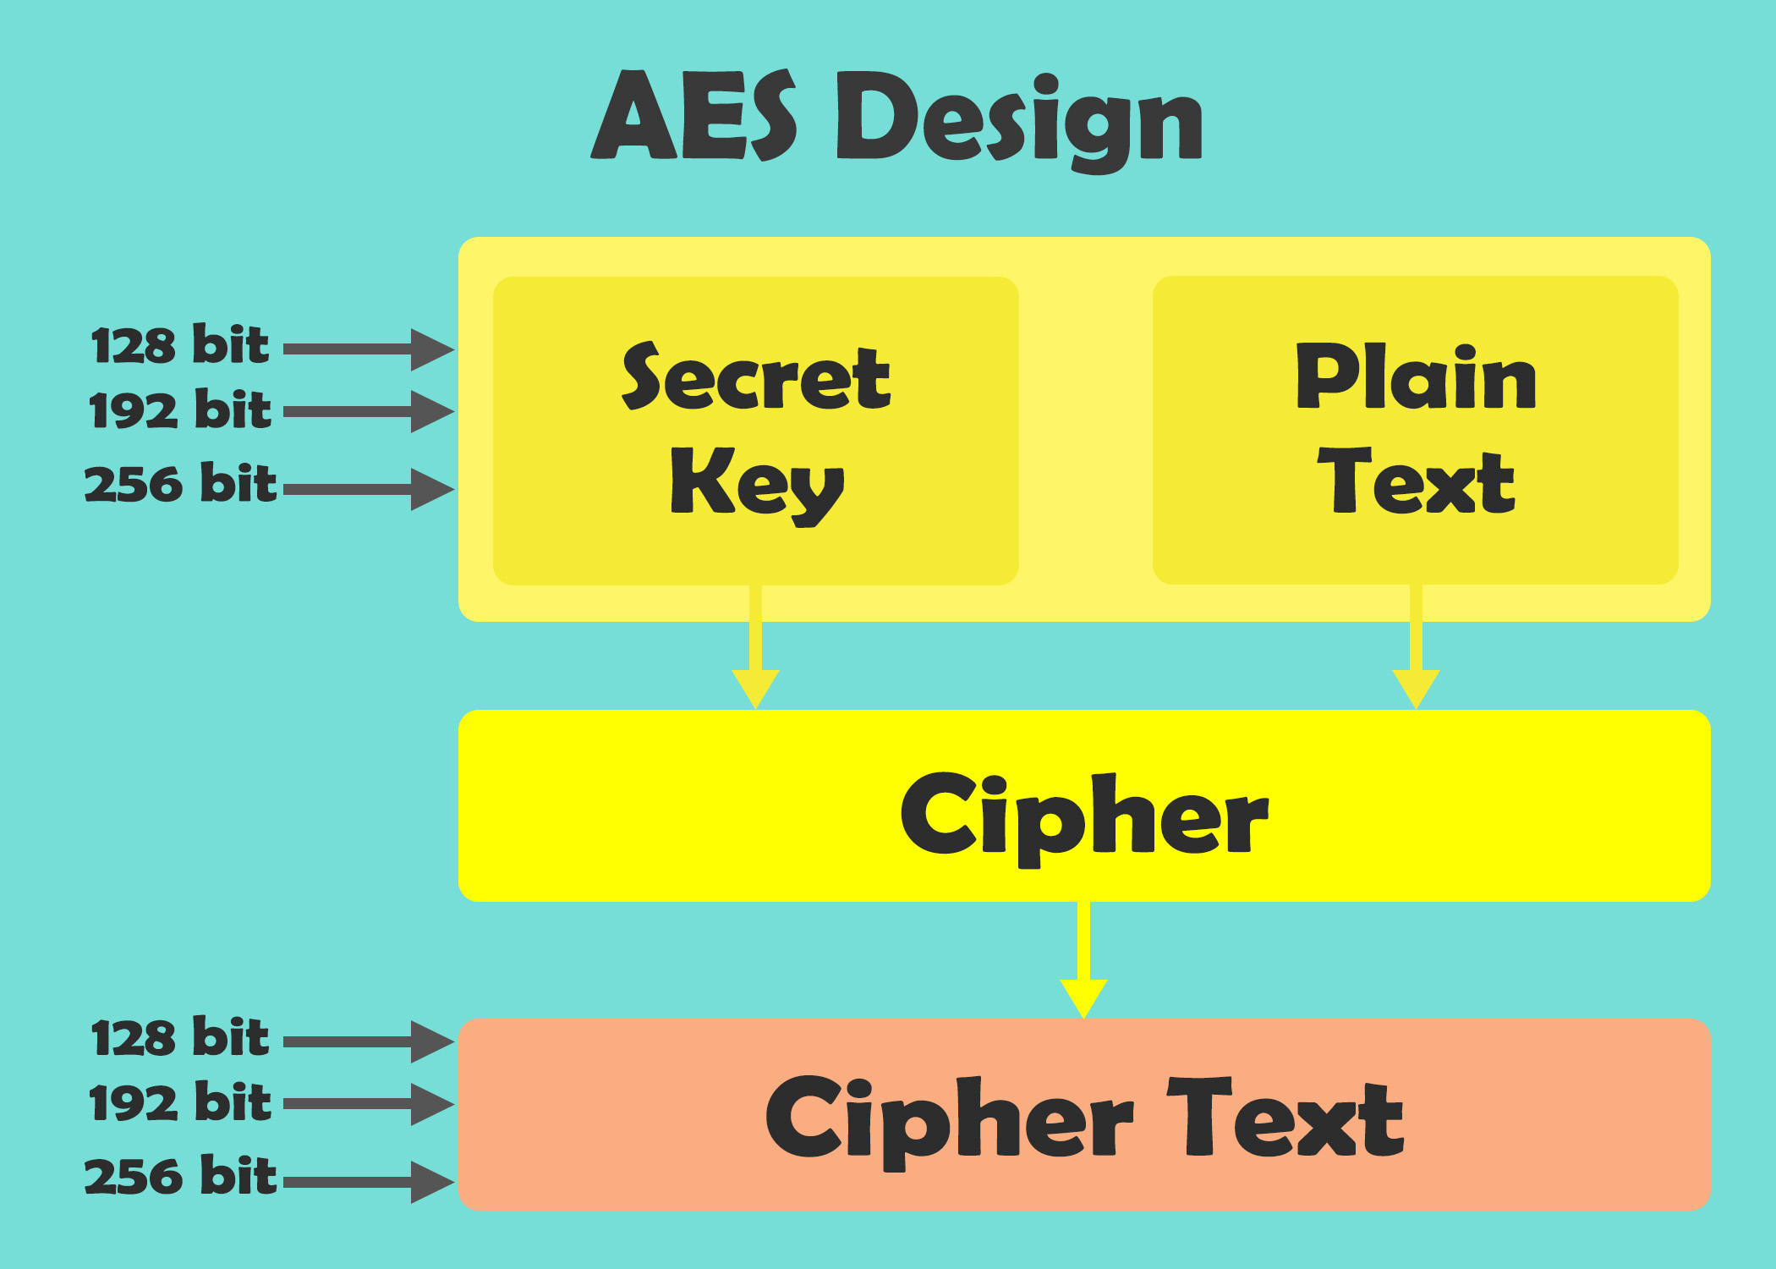
AES

Slide 21
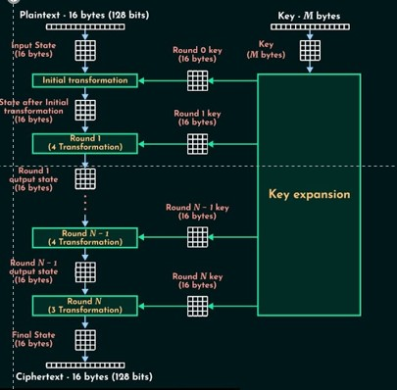
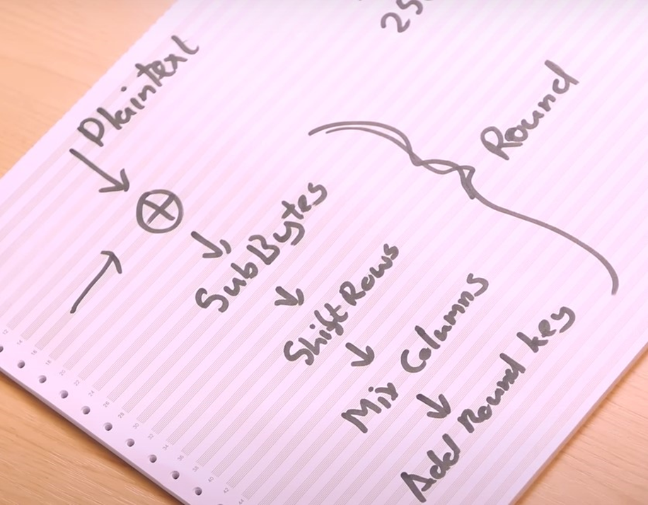

Slide 22
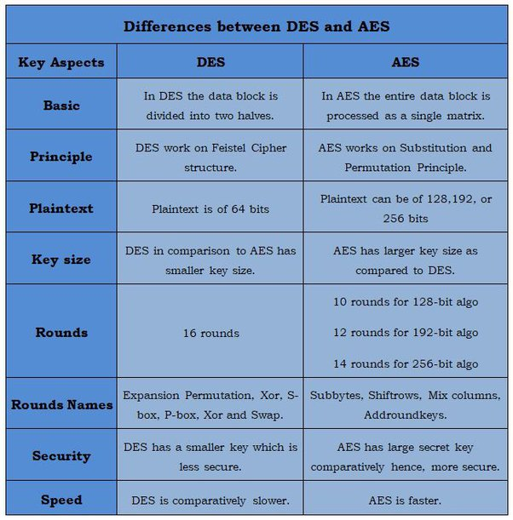

Slide 23
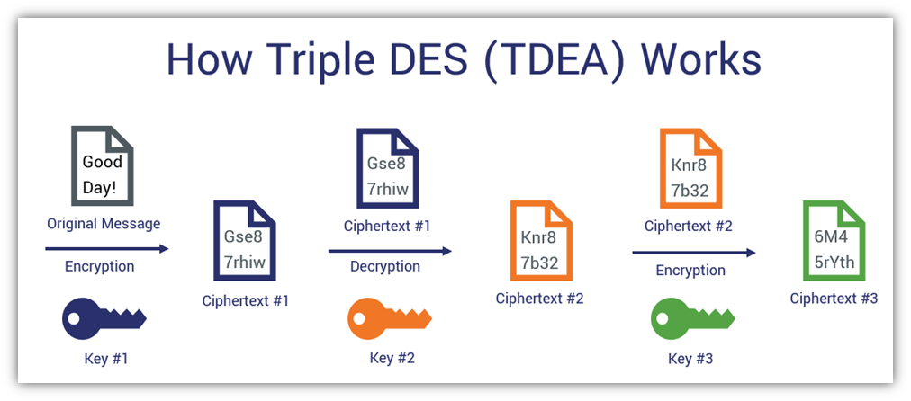
3DES

Slide 24
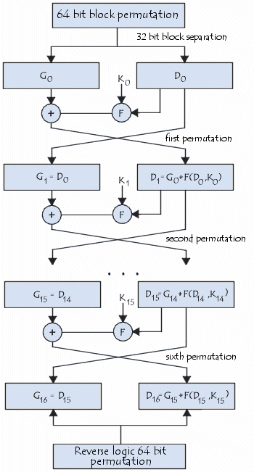

Slide 25

When can we use it?
S/MIME is often used in scenarios where email security is crucial, such as in business communication, government correspondence, or any situation where the privacy and integrity of email content are paramount.

Slide 26
Configuration
To use S/MIME, you need a digital certificate associated with your email address. This certificate includes your public key and information about your identity. Most email clients support S/MIME and have options to manage certificates and enable encryption and digital signatures.

Slide 27
Implementation
Get a Certificate: You need an S/MIME certificate, which is usually issued by a Certificate Authority (CA). This can be obtained through various providers.
Install the Certificate: Once you have the certificate, you'll need to install it on your device. This process varies depending on your operating system and email client.
Configure Email Client: Go to your email client's settings, find the security or encryption settings, and enable S/MIME. You may need to import your certificate and configure other security options.
Send Encrypted Emails: Once configured, you can start sending encrypted emails. Your email client will handle the encryption and decryption processes seamlessly.

Slide 28
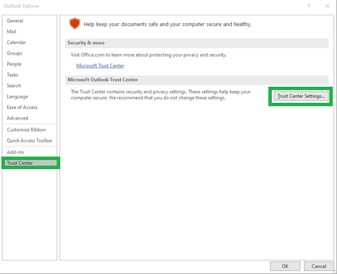
How to implement S/MIME?
Import S/MIME certificate
Open File>>Options in Outlook 2010/2013
Now, click on Trust Center > Trust Center Settings under Outlook Options.

Slide 29
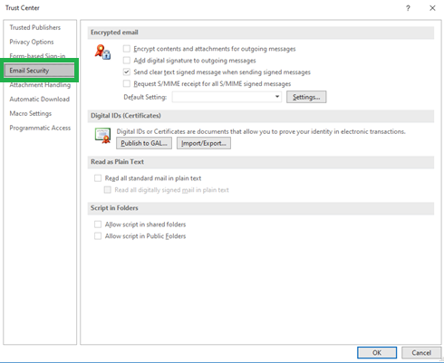
After that, click on “Trust Center Settings” button and click on “Email Security” tab on the left side.

Slide 30
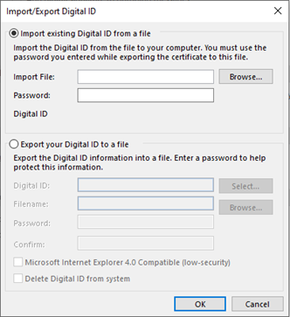
You will have Import/Export button under Digital IDs (certificates) label in the middle of the screen. Click on it.

Slide 31
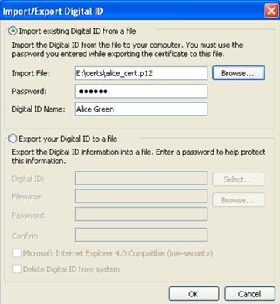
In the Import/Export Digital ID interface, Browse PKCS12 certificate file and click OK. Keep digital ID name and use password used during export of certificate.

Slide 32
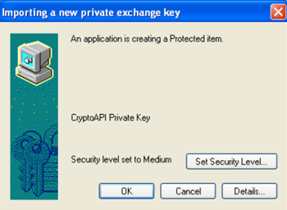
Now, select security level for storing private key and click OK.
Assign the Certificate
Open Outlook 2010/2013 and access File>>Options
Click on “Trust Center Settings” button and select “Email Security” tab on the left side.

Slide 33
Click on “Settings” under “Email Security” option as showing in above image.
You will have a “change security settings” where you can choose signing and encryption certificate.

Slide 34
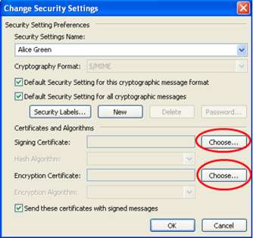
First click on choose button against signing certificate, there you can choose signing certificate from imported certificate and Click OK.
Again, click on choose button against Encryption certificate, there you can choose encryption certificate from imported certificate and click OK.
After choosing both certificates click OK button and return to the Trust Center screen.

Slide 35
Signing and Encrypting Individual Emails
First compose mail in outlook and click on Options in menu bar and click on “Encrypt” and “Sign” button as per your requirements.
When you send email, it will be encrypted and signed as per your selected option.
Signing and Encrypting All Mails by Default
Open Outlook 2010/2013 and browse File>> Options.
On the left side, click on ‘Trust Center’ and then click on ‘Trust Center Settings’ on the right side.
Choose ‘Email Security’ on the left side and select below two boxes named as:
Encrypt contents and attachments for outgoing messages box (To encrypt each message)
Add digital signature to outgoing messages box (To sign each message)
Click OK button.

